Slide 1
Machine Learning CA1
Zygimantas Jakubauskas
Miroslava Slavikova

Slide 2
Slide Title
Make Effective Presentations
Using Awesome Backgrounds
Engage your Audience
Capture Audience Attention

Slide 3
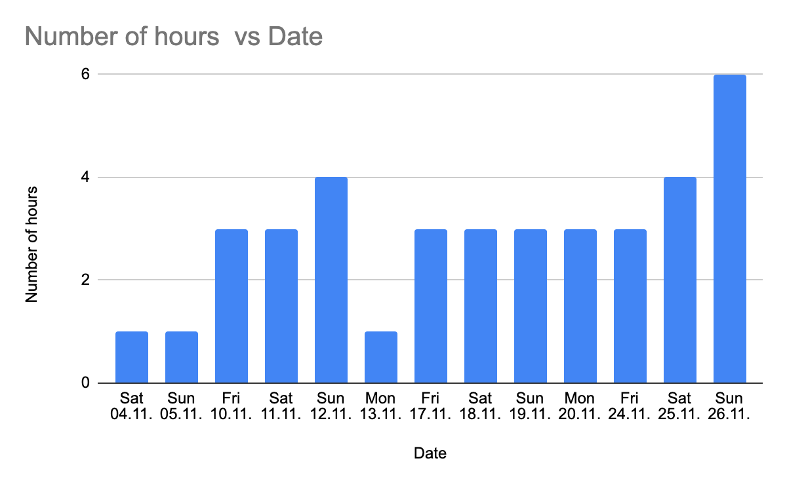
Time Spent on the Project for Miroslava

Slide 4
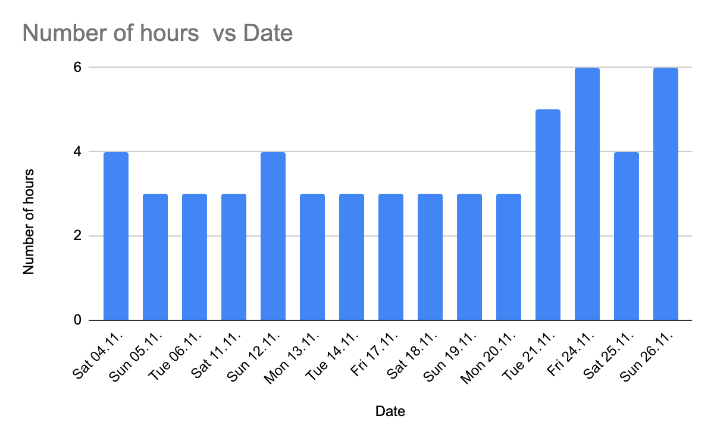
Time Spent on the Project for Zygimantas

Slide 5
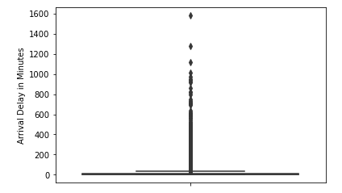
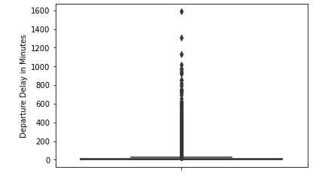
Scaling

Slide 6
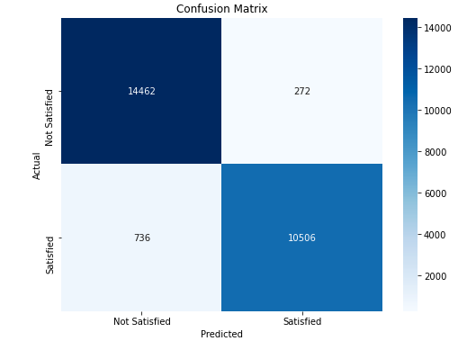
Confusion Matrix – TBD + more

Slide 7
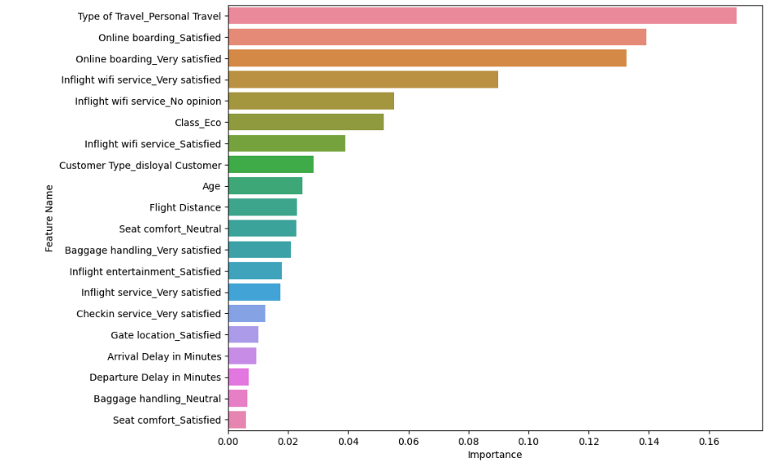
Do we show both 20 and 10 or just 10

Slide 8
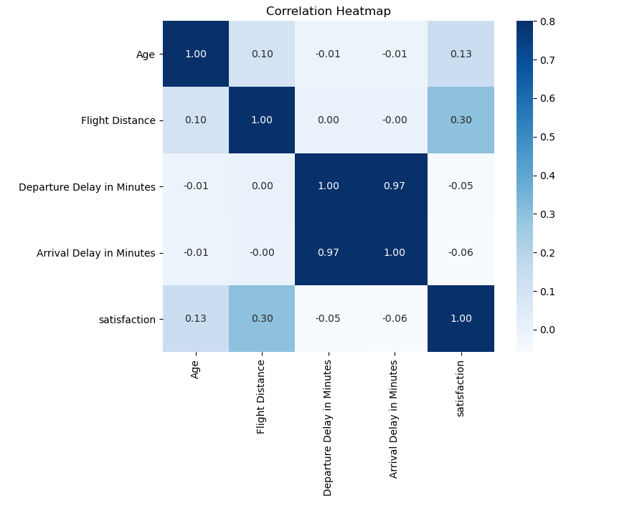
Heat Map

Slide 9
Slide Title
Product A
Product B
Feature 1
Feature 2
Feature 3
Feature 1
Feature 2
Feature 3

Slide 10
Thank you.

